Slide 1
Blizzard
By: Camryn,Doug,and vinny

Slide 2
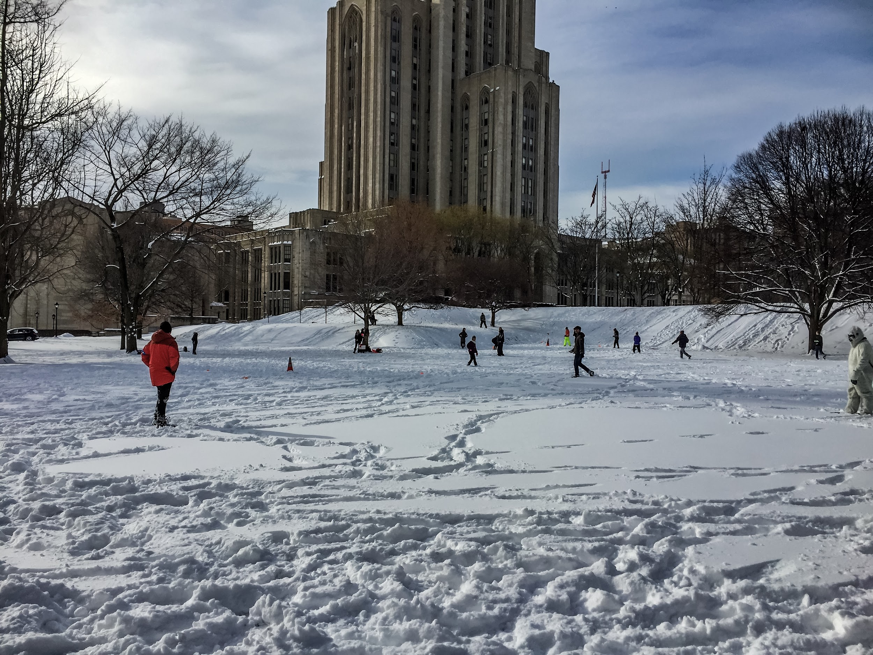
What is a Blizzard?
blizzard is a severe snow storm with high winds
Winter storms get their energy when two air masses meet

Slide 3
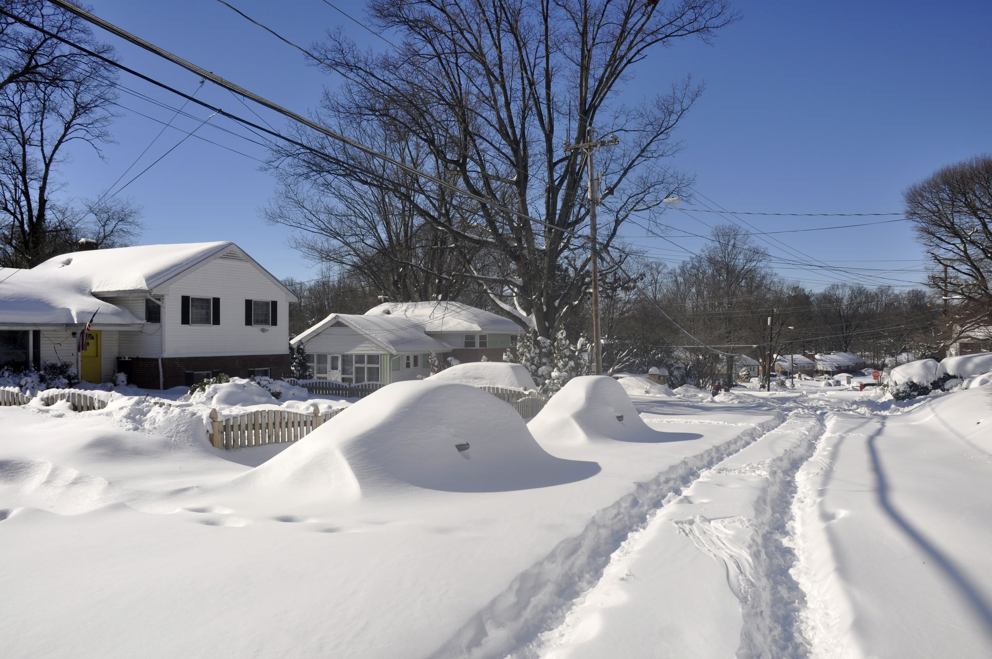
What damage does a blizzard cause?
Driving in A blizzard is very dangerous
Snow can fall on your car and get in it so you will not be able to see.

Slide 4
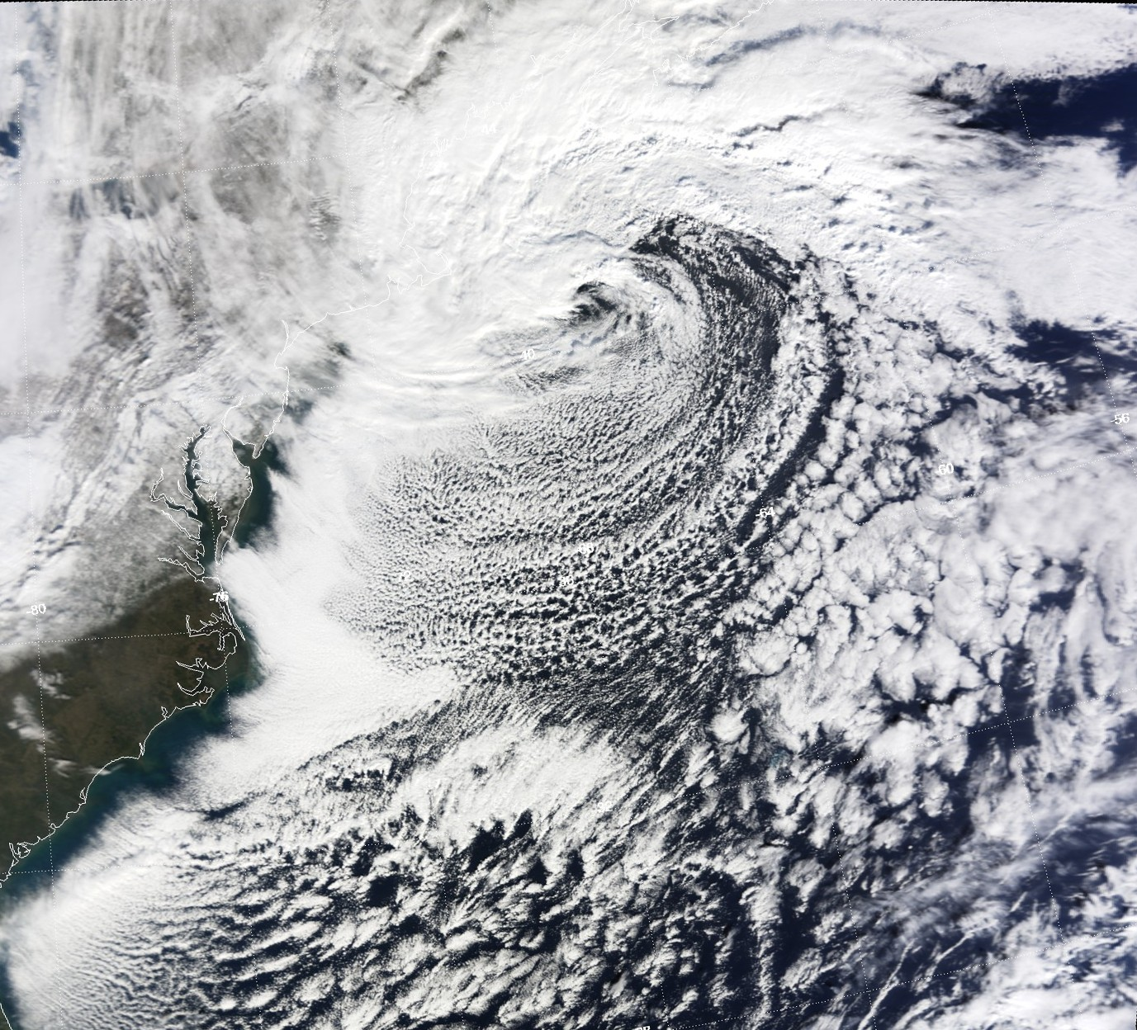
How Could Blizzards Happen?
When dark fills the sky your windows will start glowing in the darkness

Slide 5
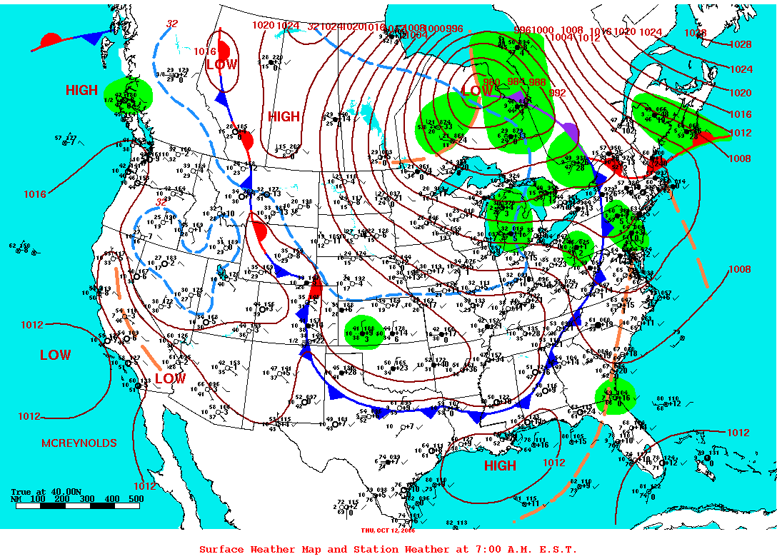
Where could a blizzard happen
A blizzard could happen at places it is about to show. Blizzards start when a high pressure systeme touches as low pressure systeme.

Slide 6
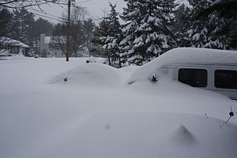
How to stay safe in a Blizzard
lots of close Stay inside
Keep warm
Do not drive in a blizzard
If you have to go outside wear

Slide 7
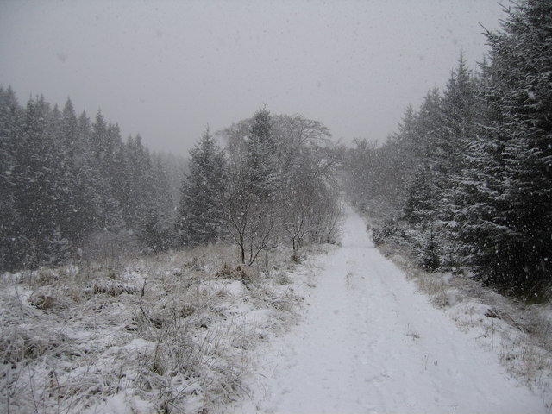
What does a blizzard look like
A blizzard looks like a white fuzzy spots comeing down to cover the ground. But kinda slow to. It looks like small mountins of snow to.

Slide 8
Websites Used
www.kidsconnect.com
Wipeout: A book about Blizzards

