Slide 1
Floods
By Conlan, Ava, and Bronwyn

Slide 2
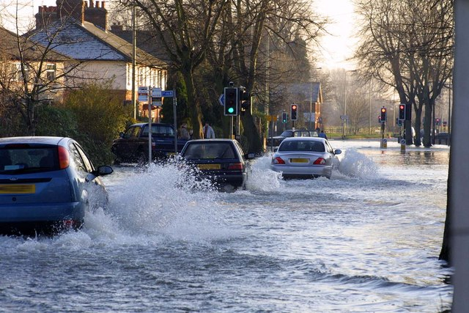
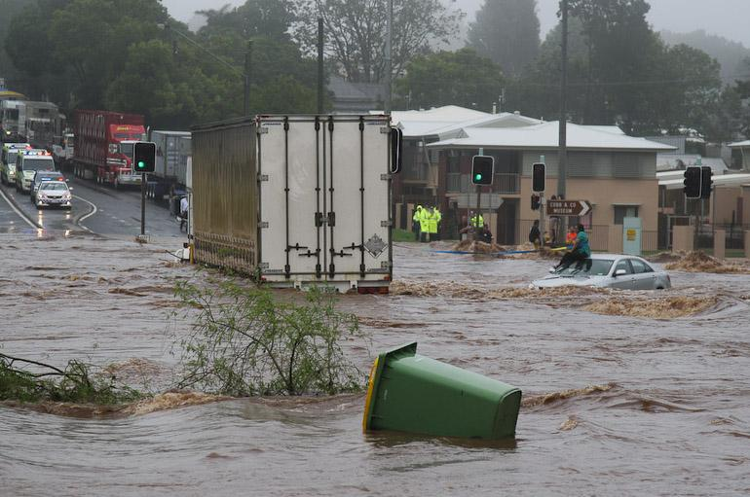
What is a flood
Sometimes a river gets more water than it needs casing a flood.Speedy, heavy water fastly zooming from sea.

Slide 3
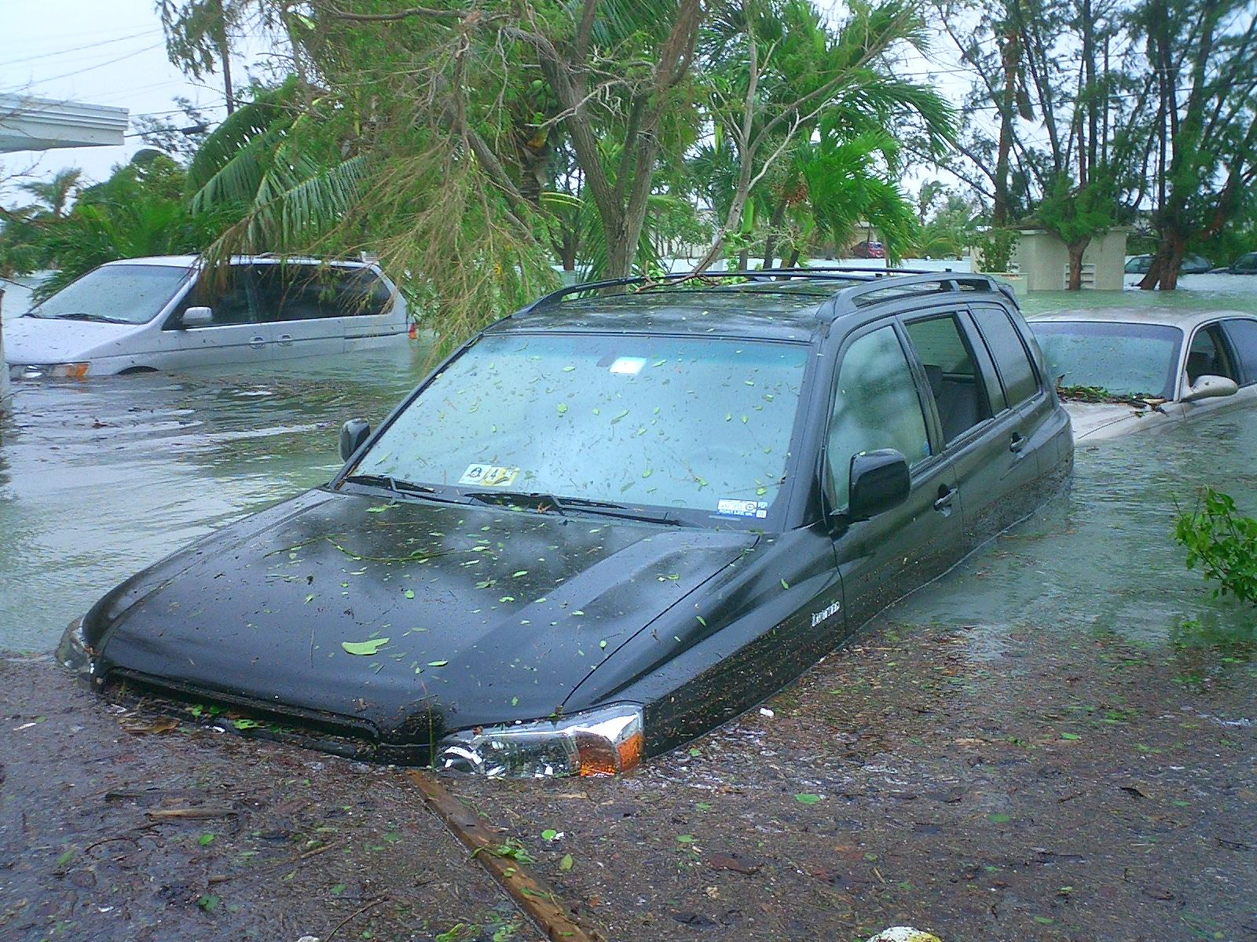
Flood damage
2 feet of water can get a car to float
Floods can cause diseases

Slide 4
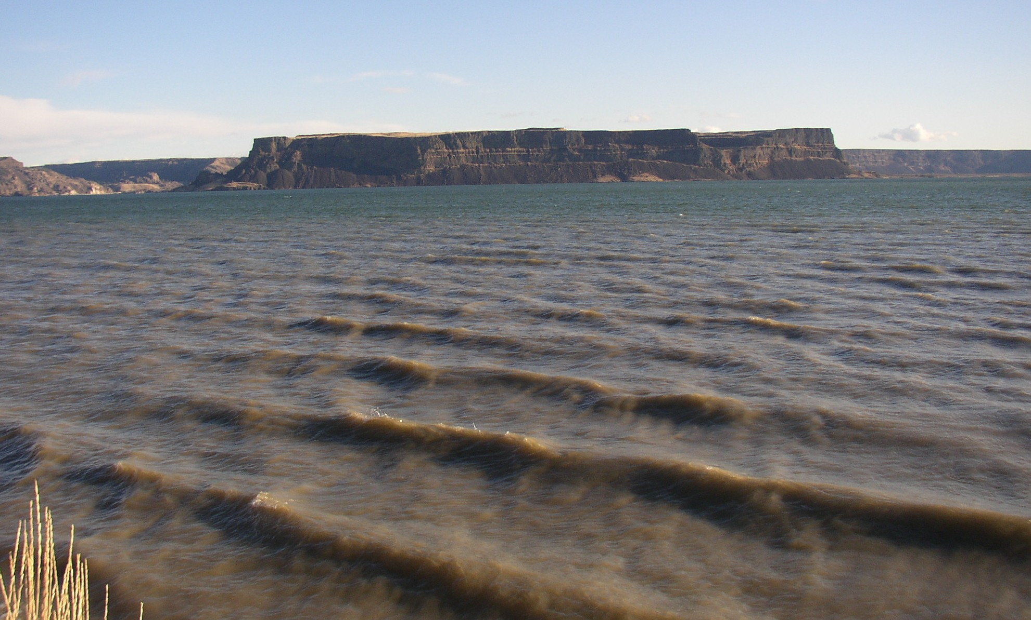
How Do Floods Form
If there is to much rain it can cause a flood
If a river overfloows it can cause a flood
To much rain can cause a flood
A lot of melted snow can form a flood

Slide 5
How To Predict Floods?
Meteorologists use special tools to predict the weather
Meteorologists also use high-tech computers to find the weather

Slide 6
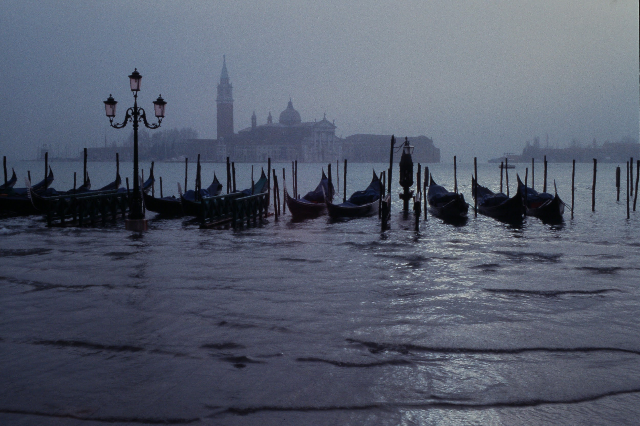
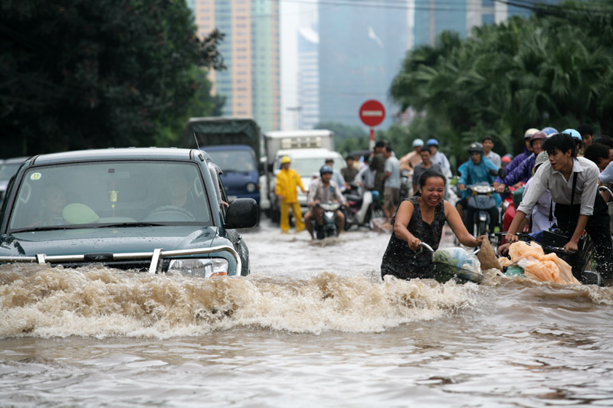
Where floods happen
In 1953 the north sea flooded the netherlands.
In 2007 rivers all over britain flooded.

Slide 7
Websites Used
https://kidskonnect.com/science/flood

