Slide 1
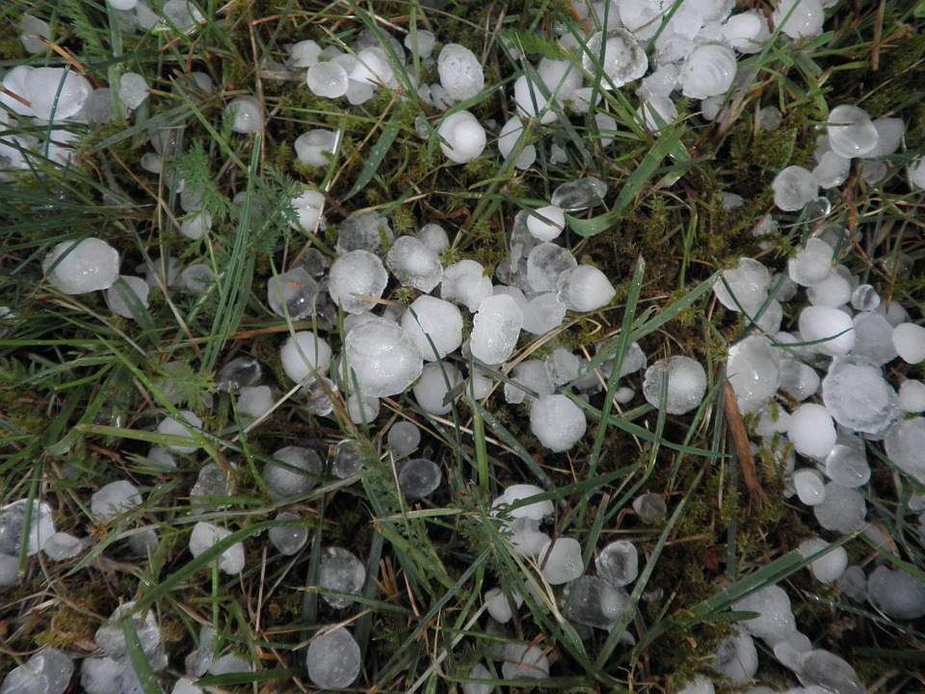
Hail of Extreme Weather
By Brady, Caitlin and Noah

Slide 2
Where does hail happen?
hail is most common in Kansas city
The Bermuda triangle

Slide 3
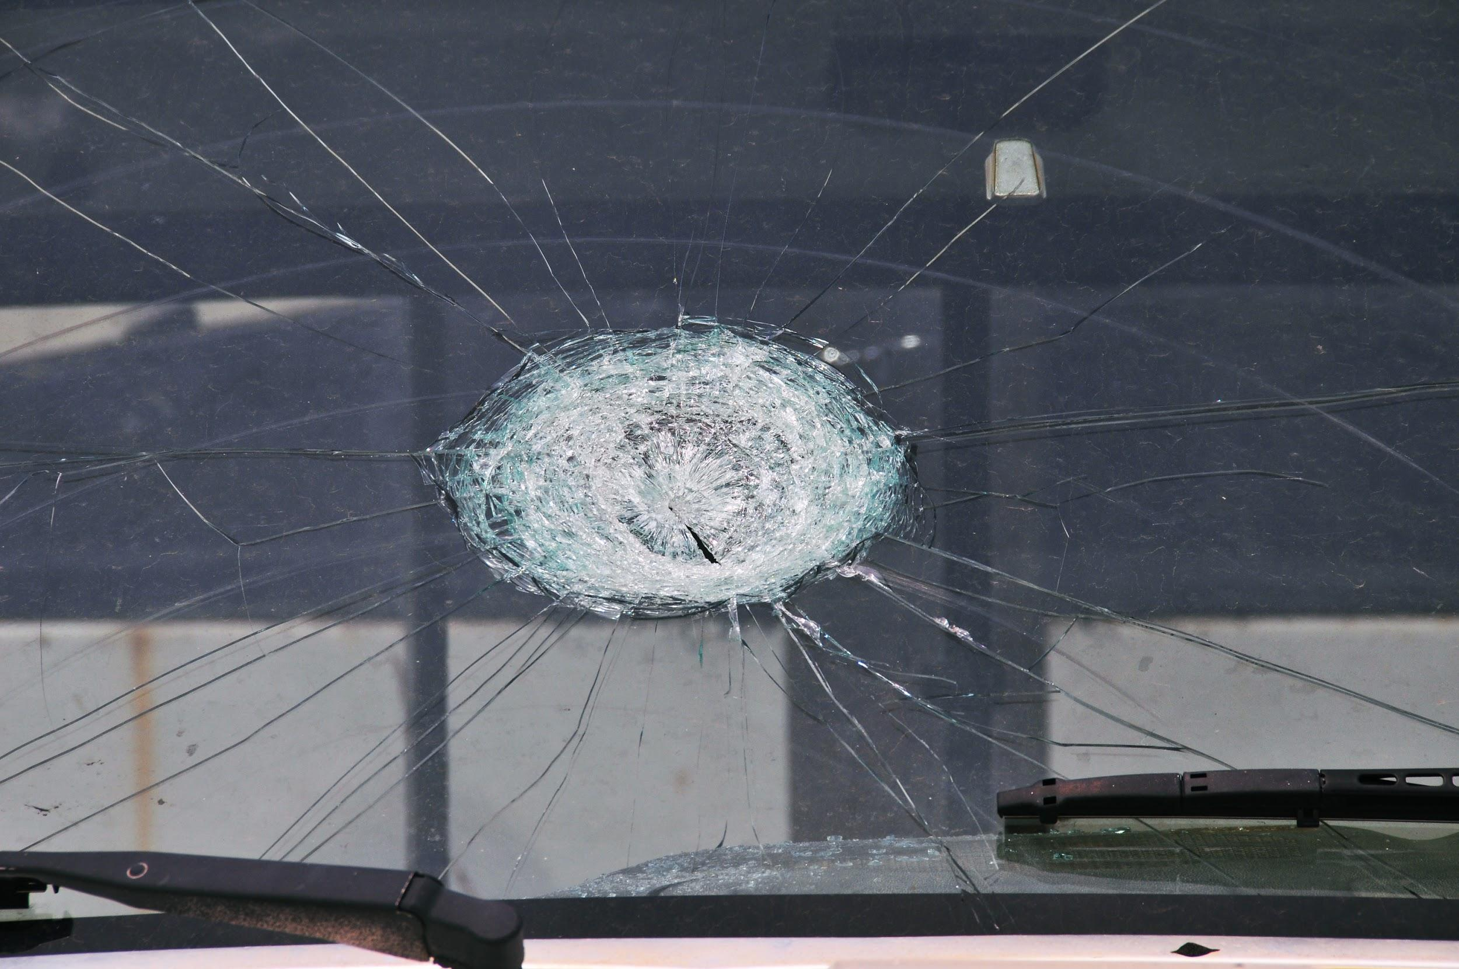
How can Hail cause all sorts of damage
A hailstone is very dangerous because it can dent cars it can also kill small animals

Slide 4
What is hail
Hail starts as water in the sky and since the water in the sky is close to cold space, it freezes then falls.

Slide 5
how hail forms
Another fact is the cloudy ice freezes and trapping all the smaller air bubbles
Hail forms with extremely cold water

Slide 6
What websites we used
Kidsgeo.com
Kidsearch.com

