Slide 1
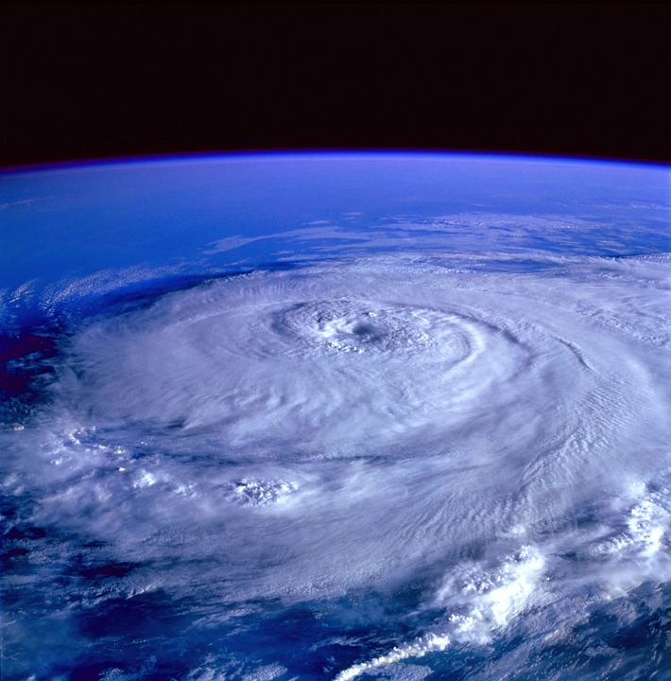
Hurricane
By Maia, Patrick, EJ and Zach

Slide 2
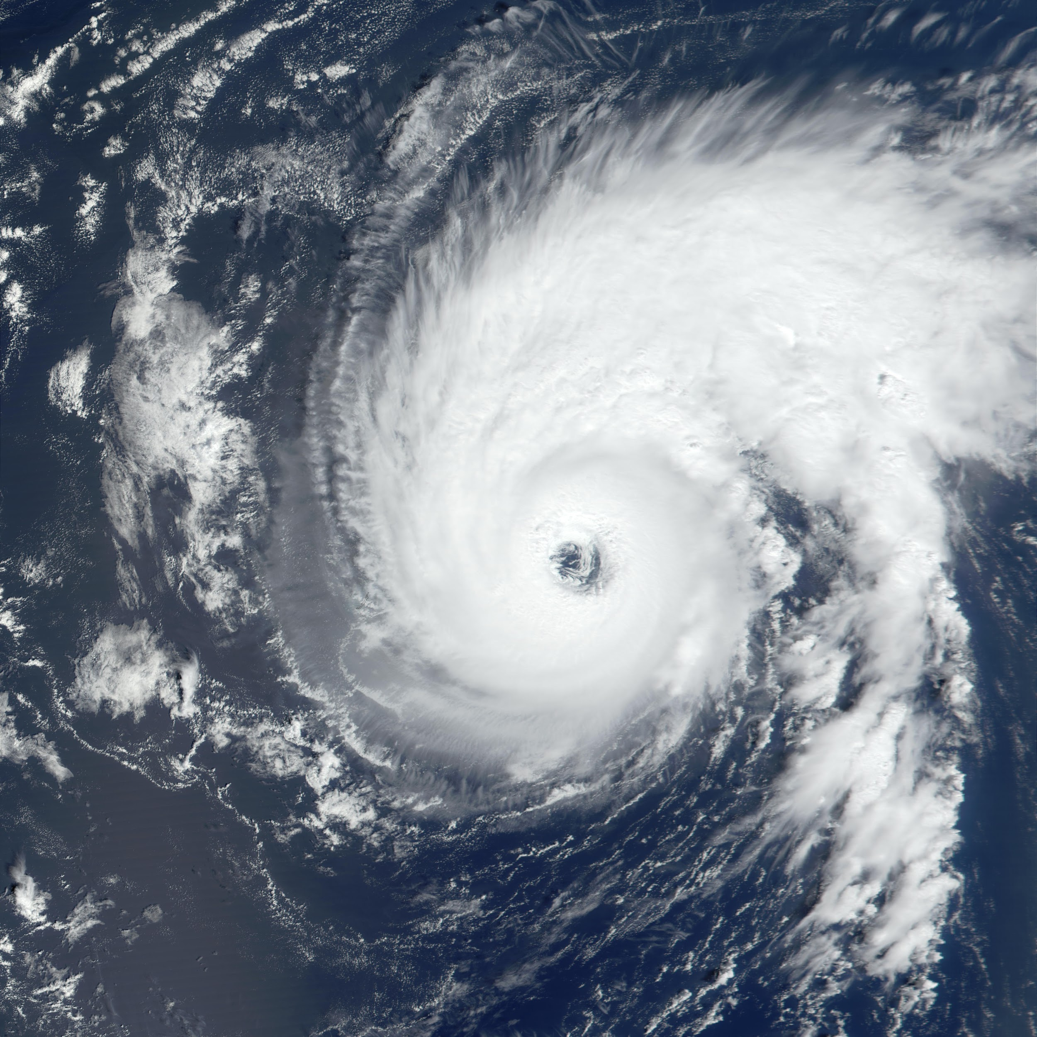
What is a hurricane?
A hurricane is a huge storm
The storm forms in a circle with big winds on the outside and an eye on the inside
A hurricane is an example of extreme weather
It can be up to 600 miles wide
The eye has light winds and less rain

Slide 3
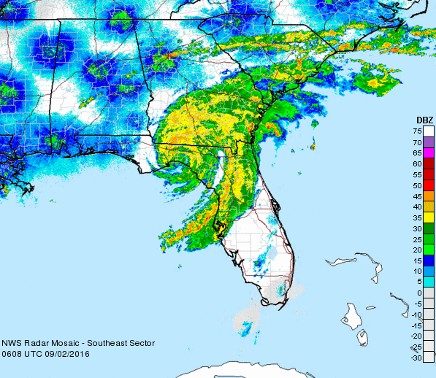
The conditions of a hurricane
Winds up to 120.7 mph
If you are in the eye of the storm you are fine but another half is coming
The storm mph 39-74

Slide 4
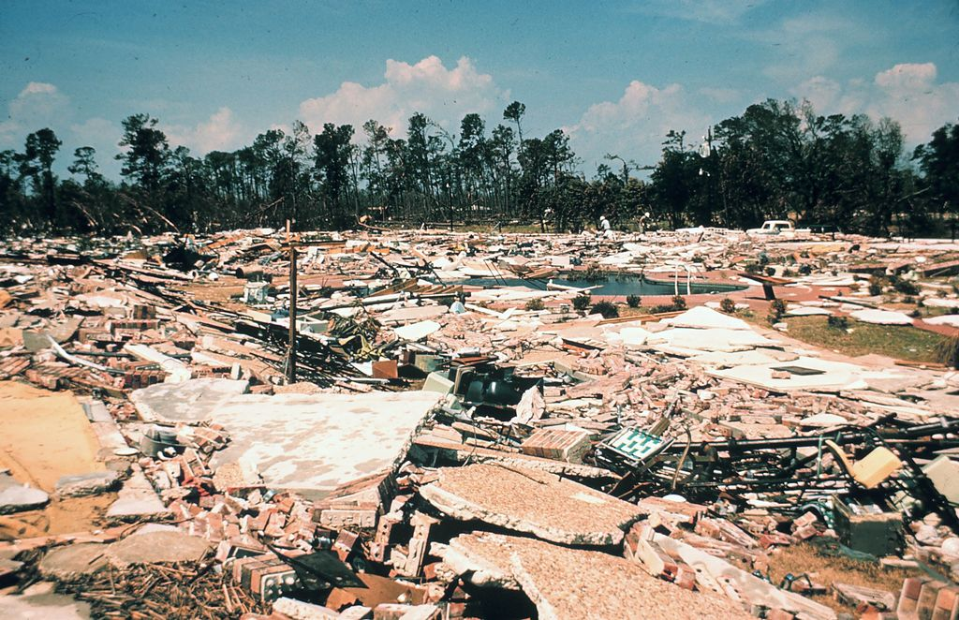
What damage does a hurricane cause?
Large waves can destroy a car, a bus, or a house
Wild winds can blow down a tree
Heavy rains can cause floods roads, sidewalks, and homes

Slide 5
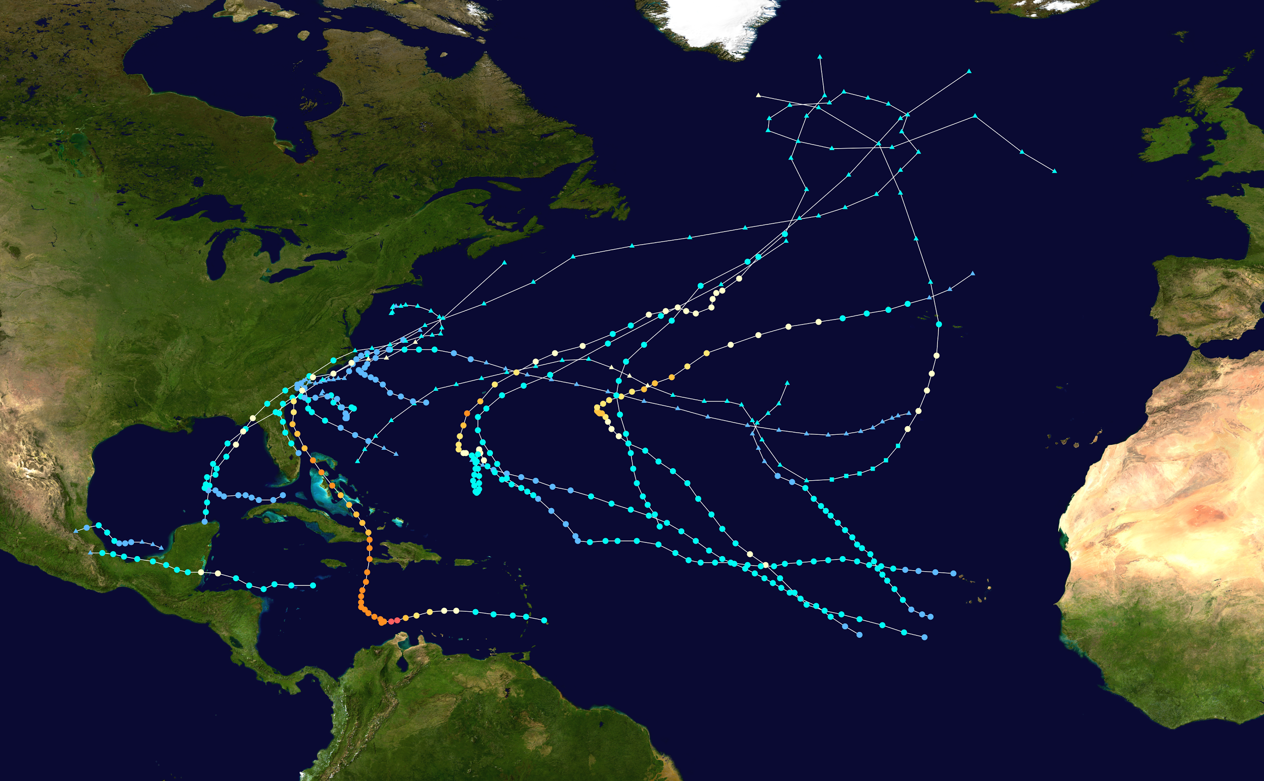
How long does a hurricane last?
It can also last a week
It wrecks everything
A hurricane can last up to 1/2 days

Slide 6
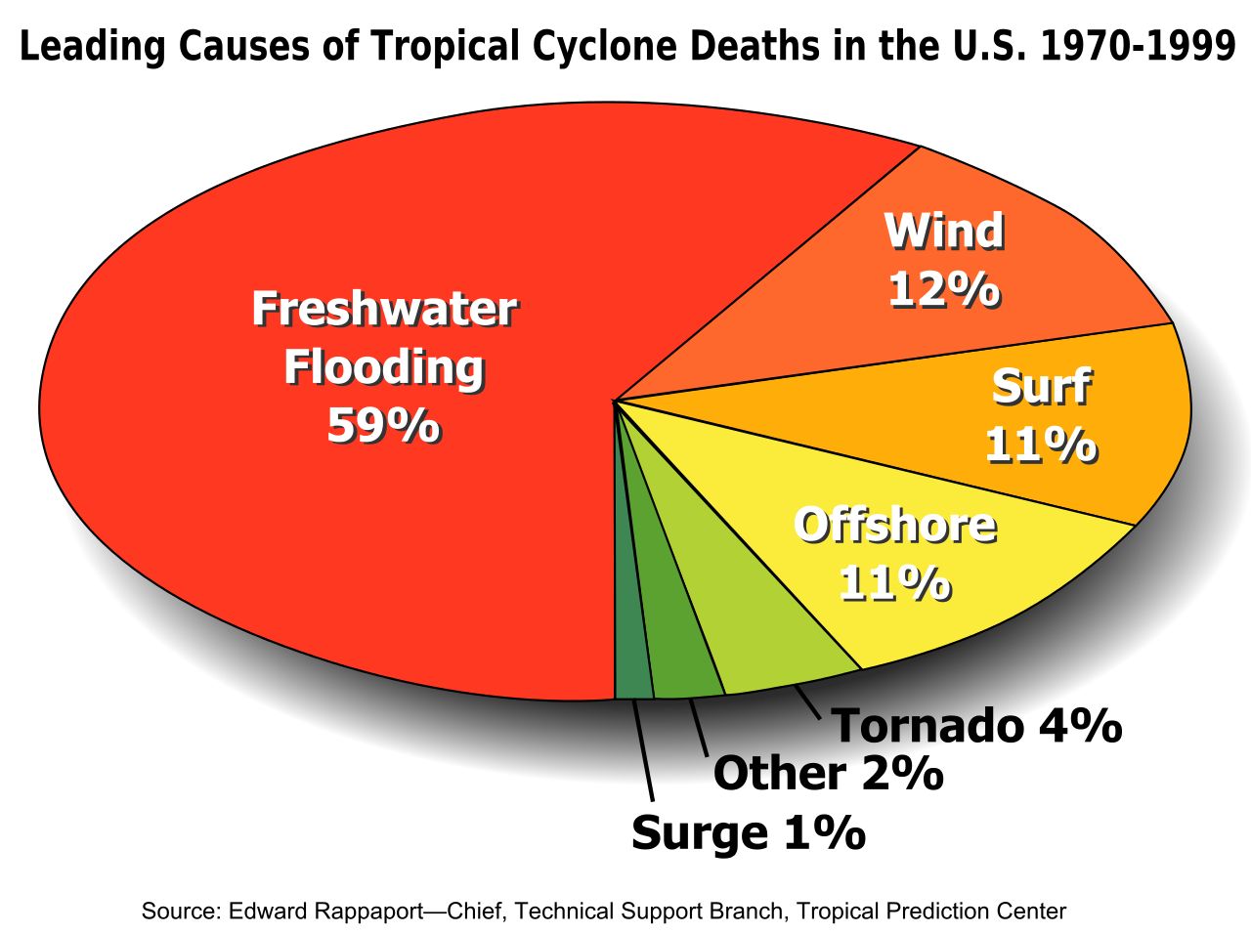
What makes a Hurricane?
Powerful winds heavy rain
Hot wind and cold winds whooshing around
Hard blowing winds

Slide 7
What is the calmest part
The calmest part is the eye
The eye will never move the eye is always calm
If you are in the eye you are fine

Slide 8
Websites used
http://www.weatherwizkids.com/weather-hurricane.htm
http://www.ngkids.co.uk/science-and-nature/Hurricanes

