Slide 1
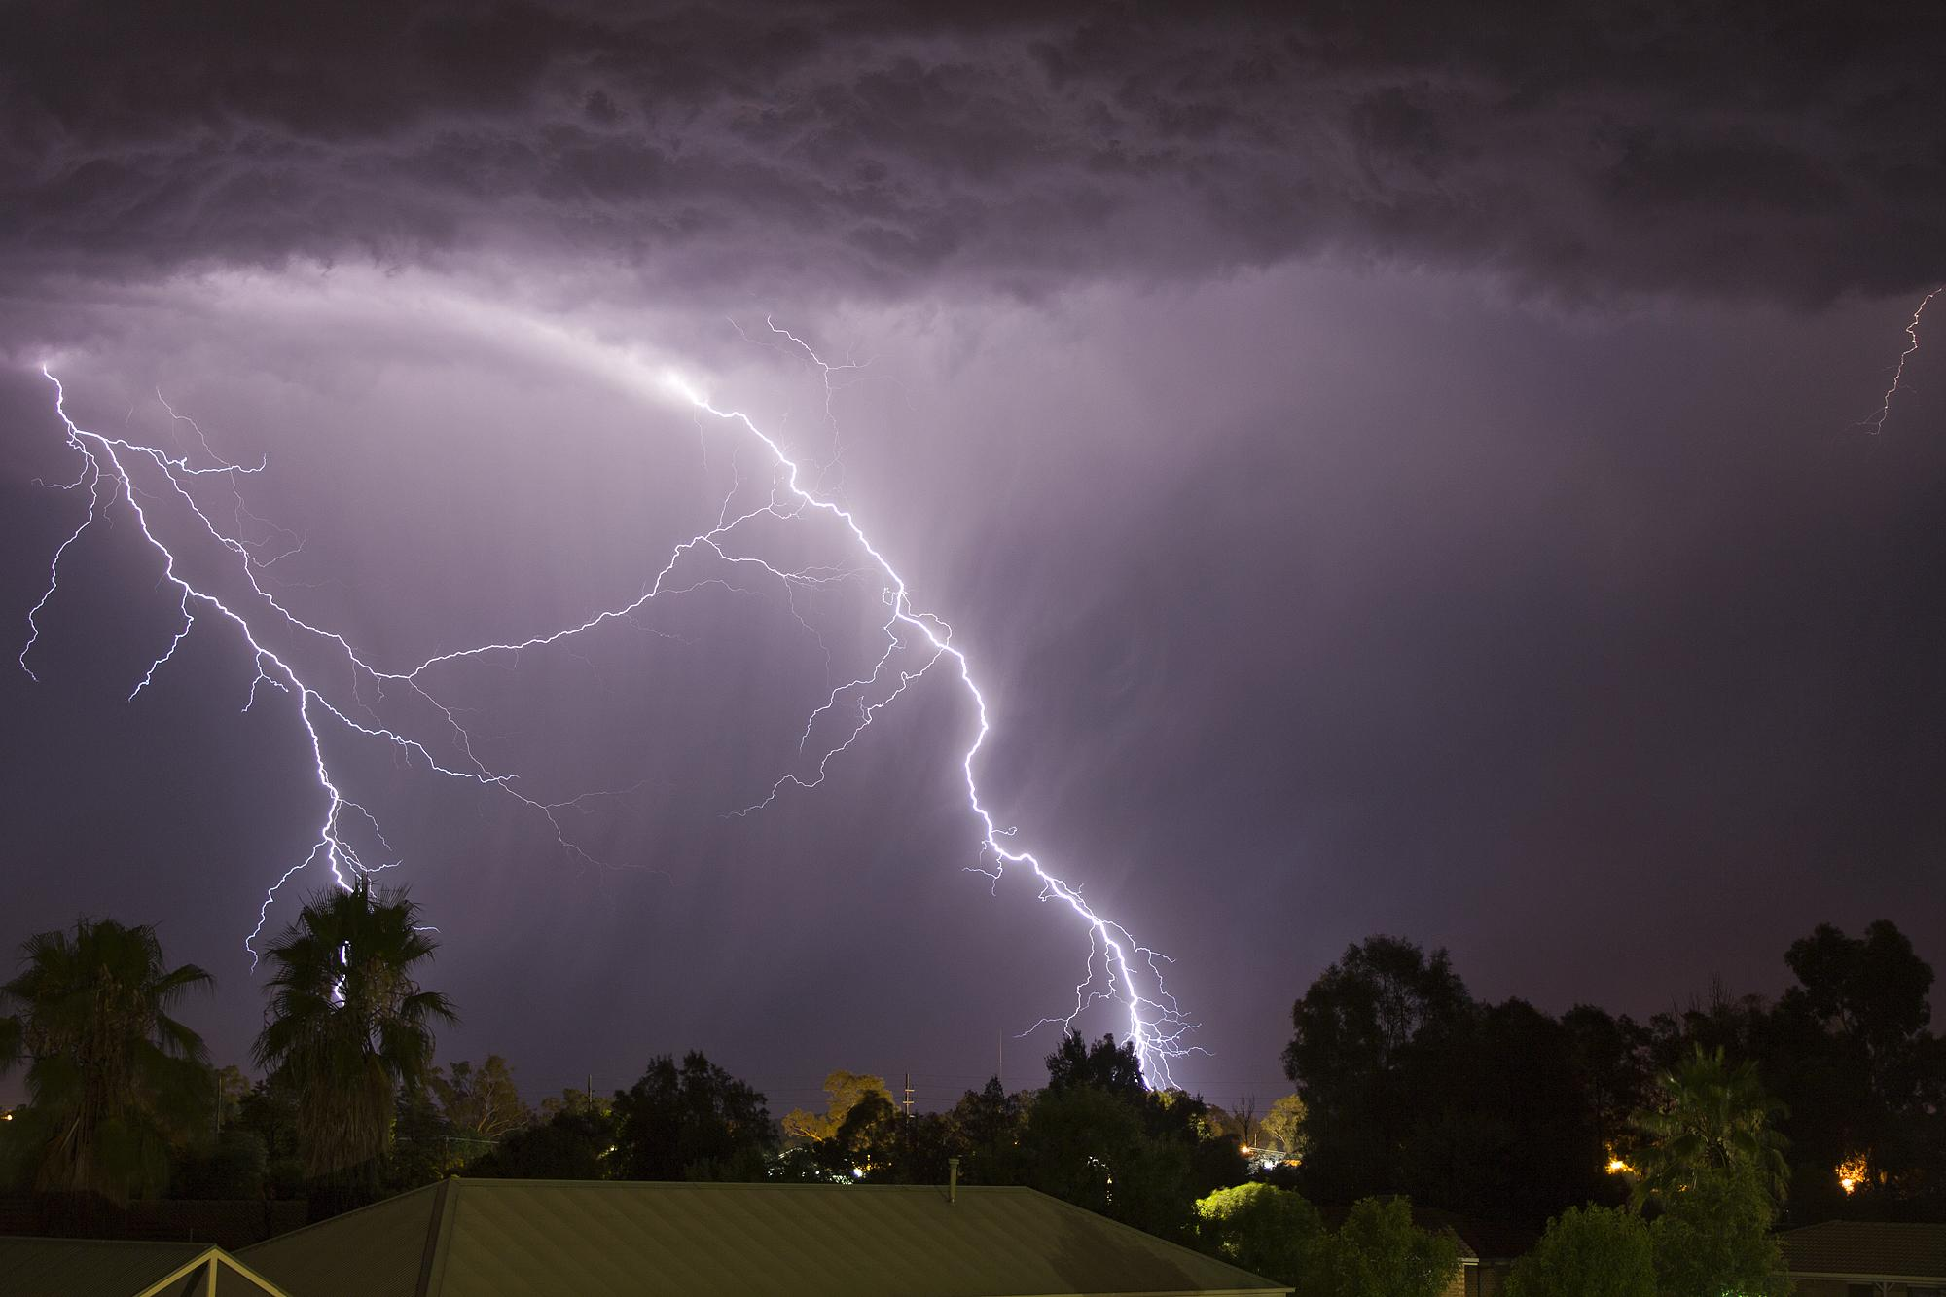
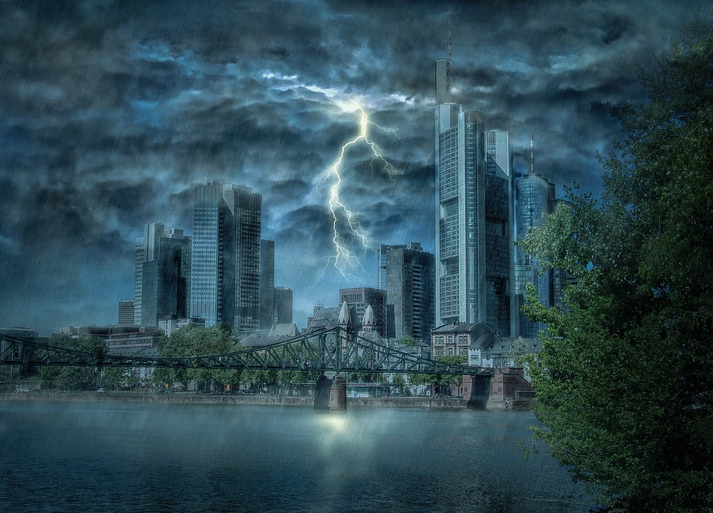
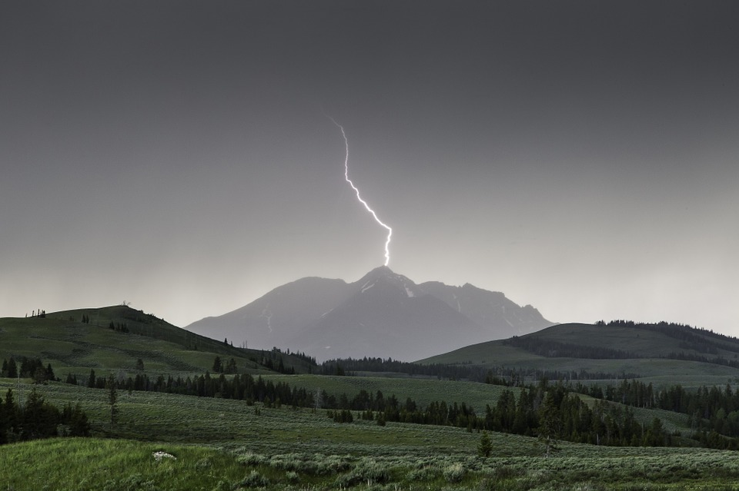
Thunder storm
By Brody Kiley, Ellie Williams and Addison Hall

Slide 2
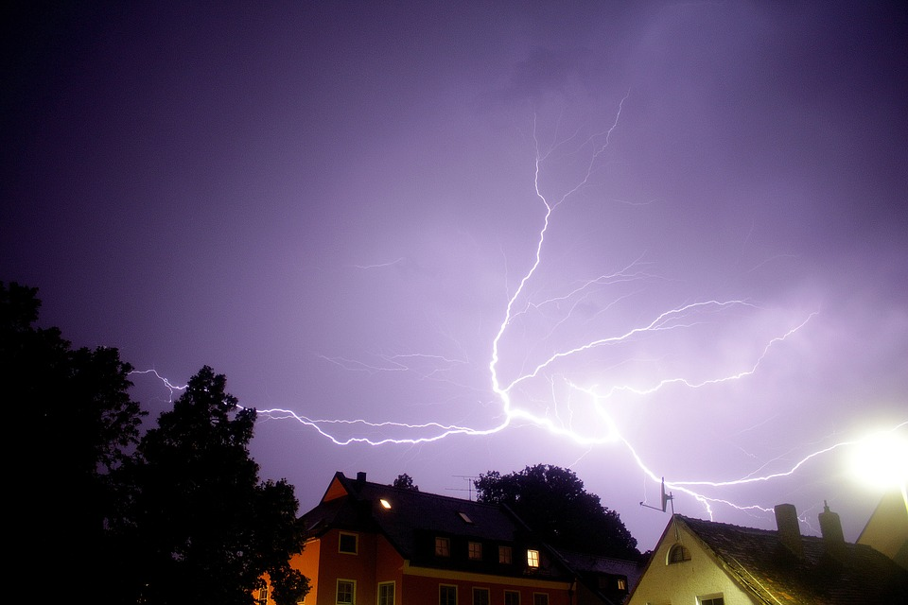
What is a Thunderstorm?
Thunderstorms have thunder, sometimes lightning, heavy rains and winds.
They usually happen when the air is very warm and humid.

Slide 3
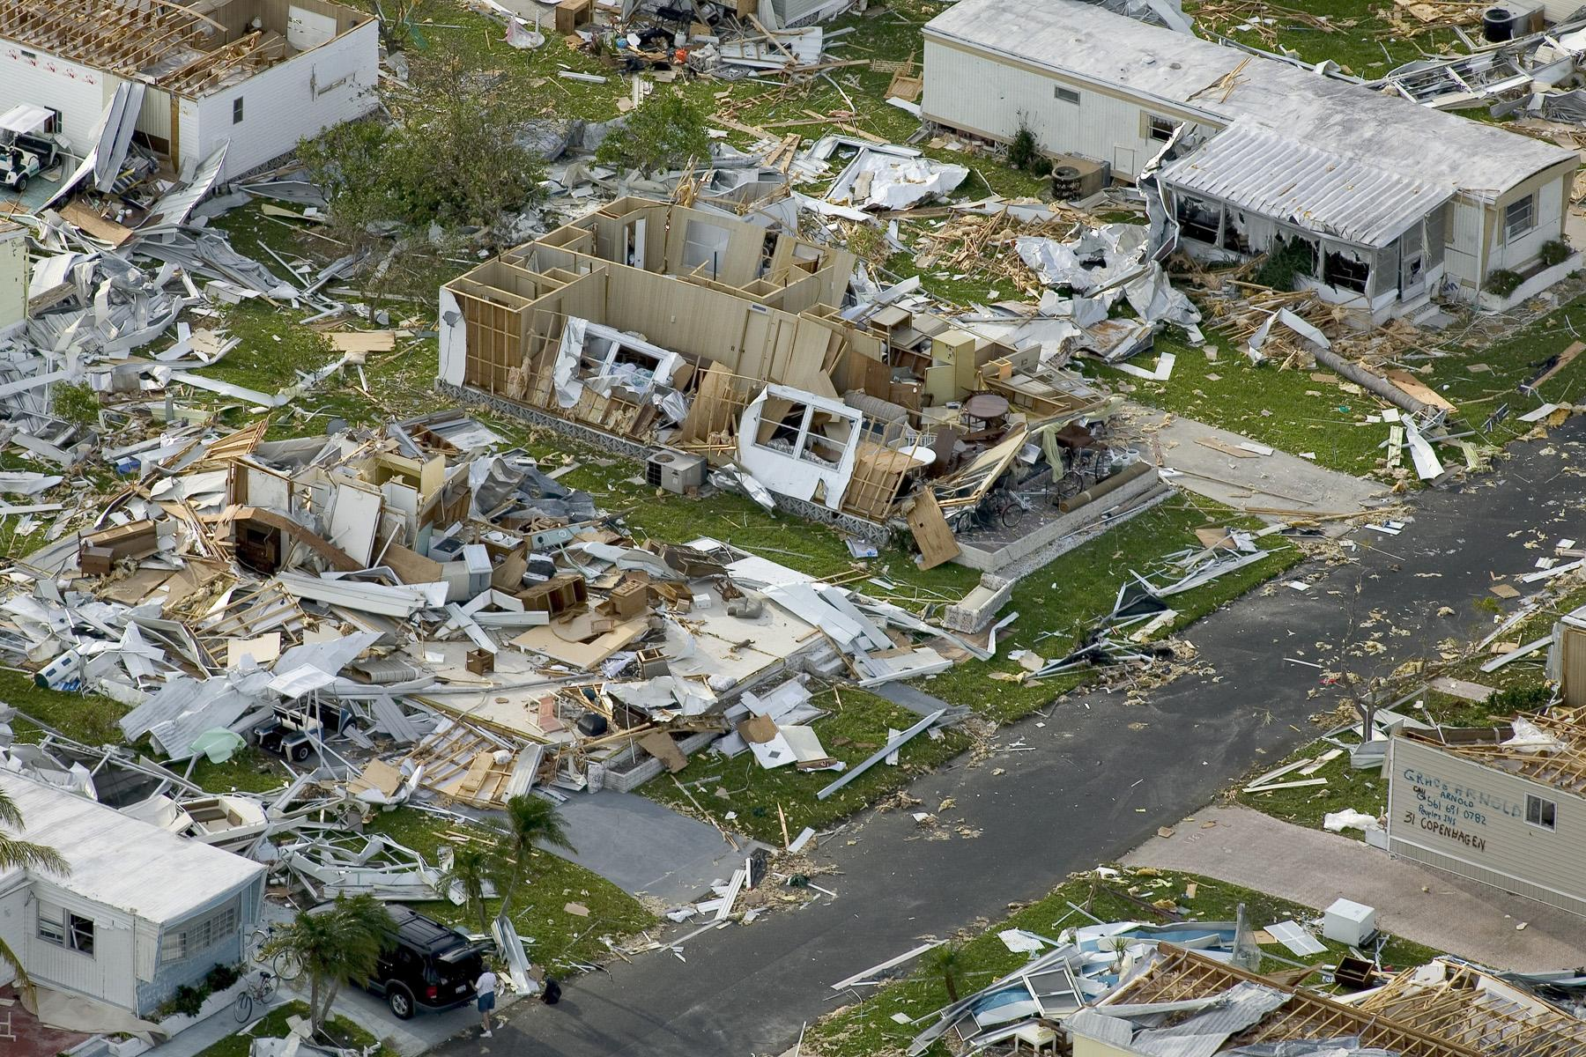
Damage
A shock of lightning can make your heart stop.
Give you burns
And can make you have brain loss
Don’t be in water in a thunderstorm. Water carries electricity

Slide 4
How many thunderstorms are there every day
It’s an estimate that 2,000 thunderstorms cross parts of the U.S.A every day.
1,800 thunderstorms can happen as fast as the time it takes you to read a book.

Slide 5
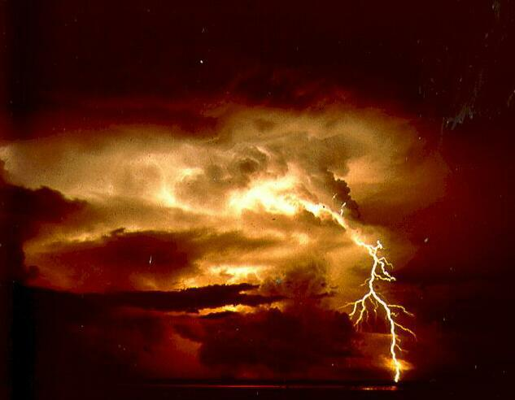
How Thunderstorms are Made
Ice and water drops are moving around about to be put together making lightning.
Winds, cold air and warm air can help form a thunderstorm.

Slide 6
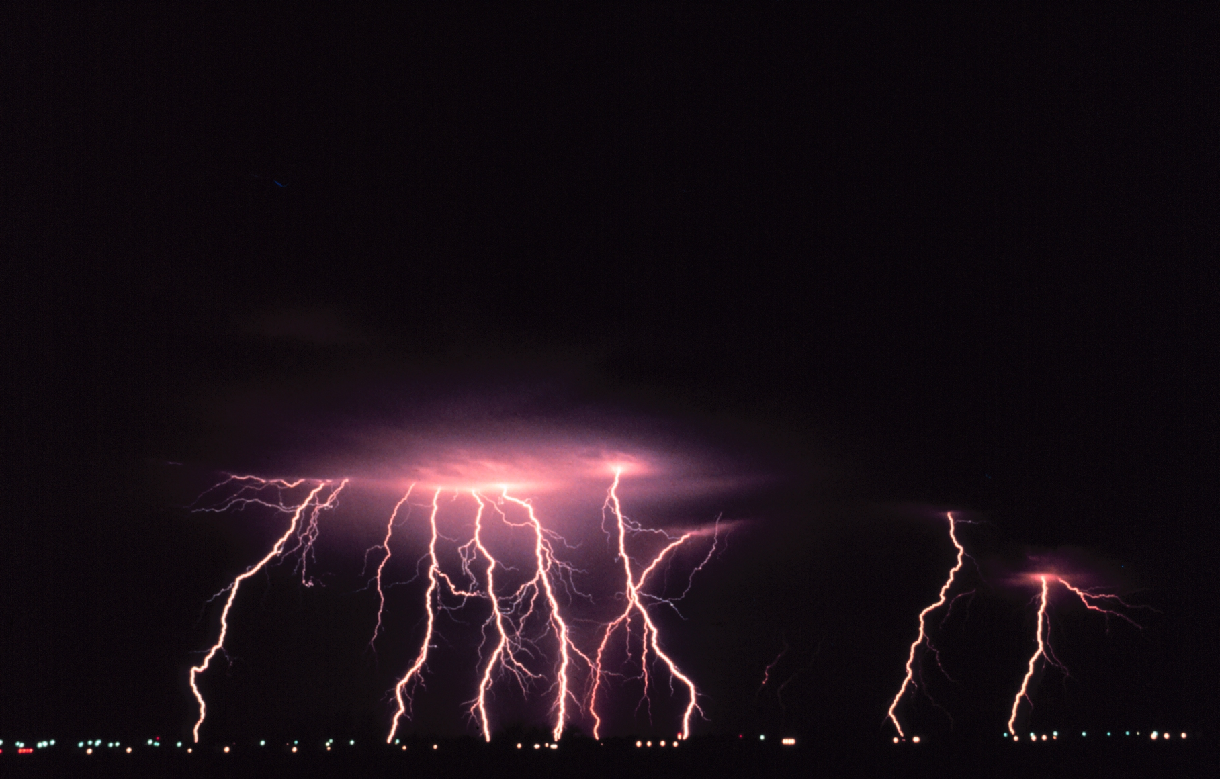
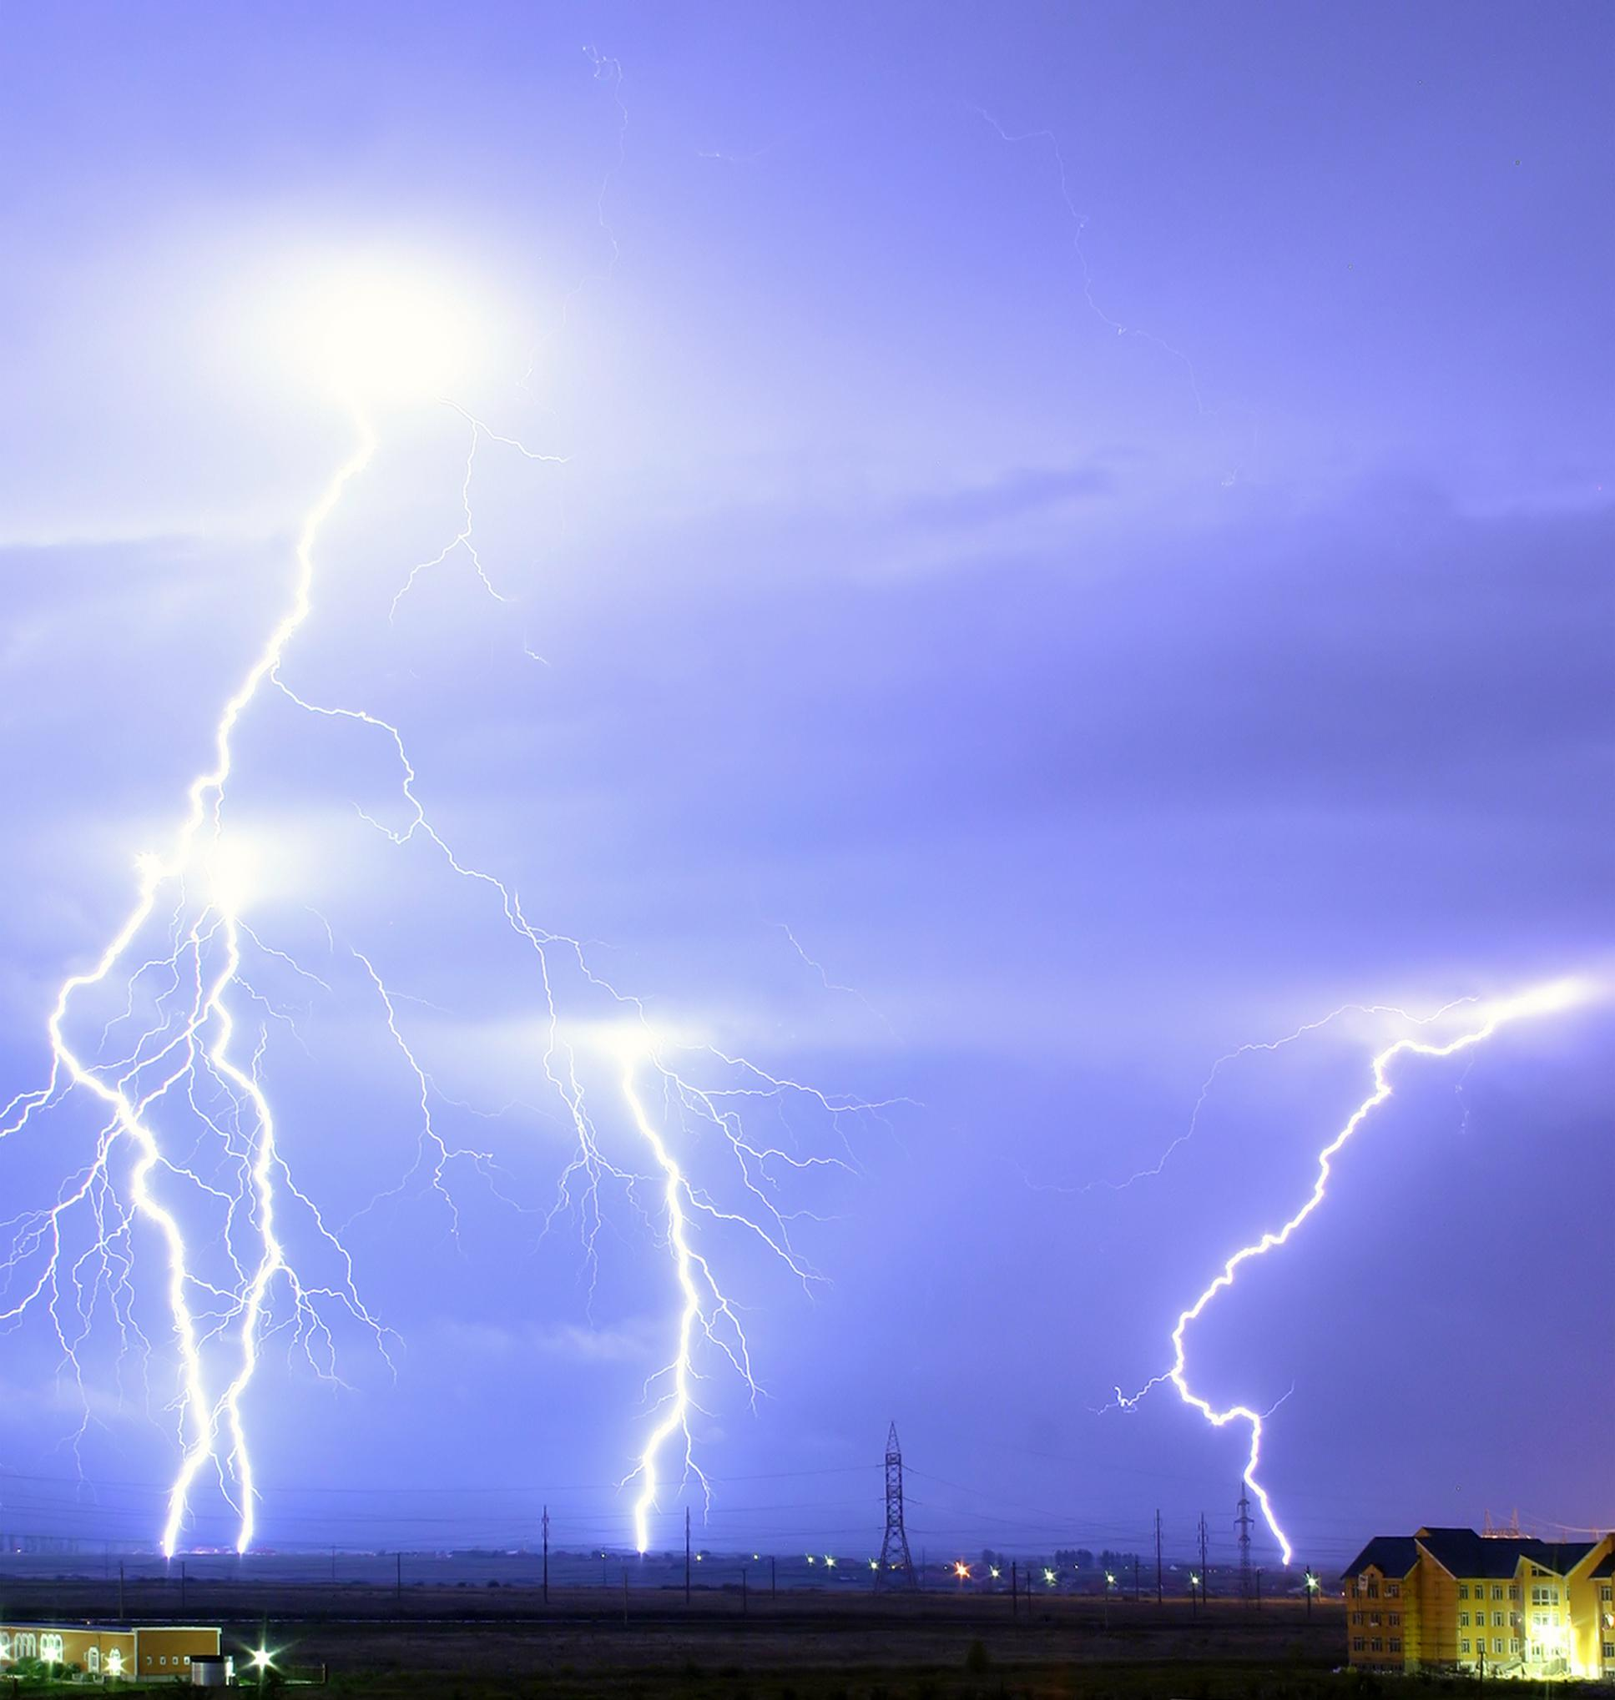
What is lightning
Lightning is a bright flash of electricity.

Slide 7
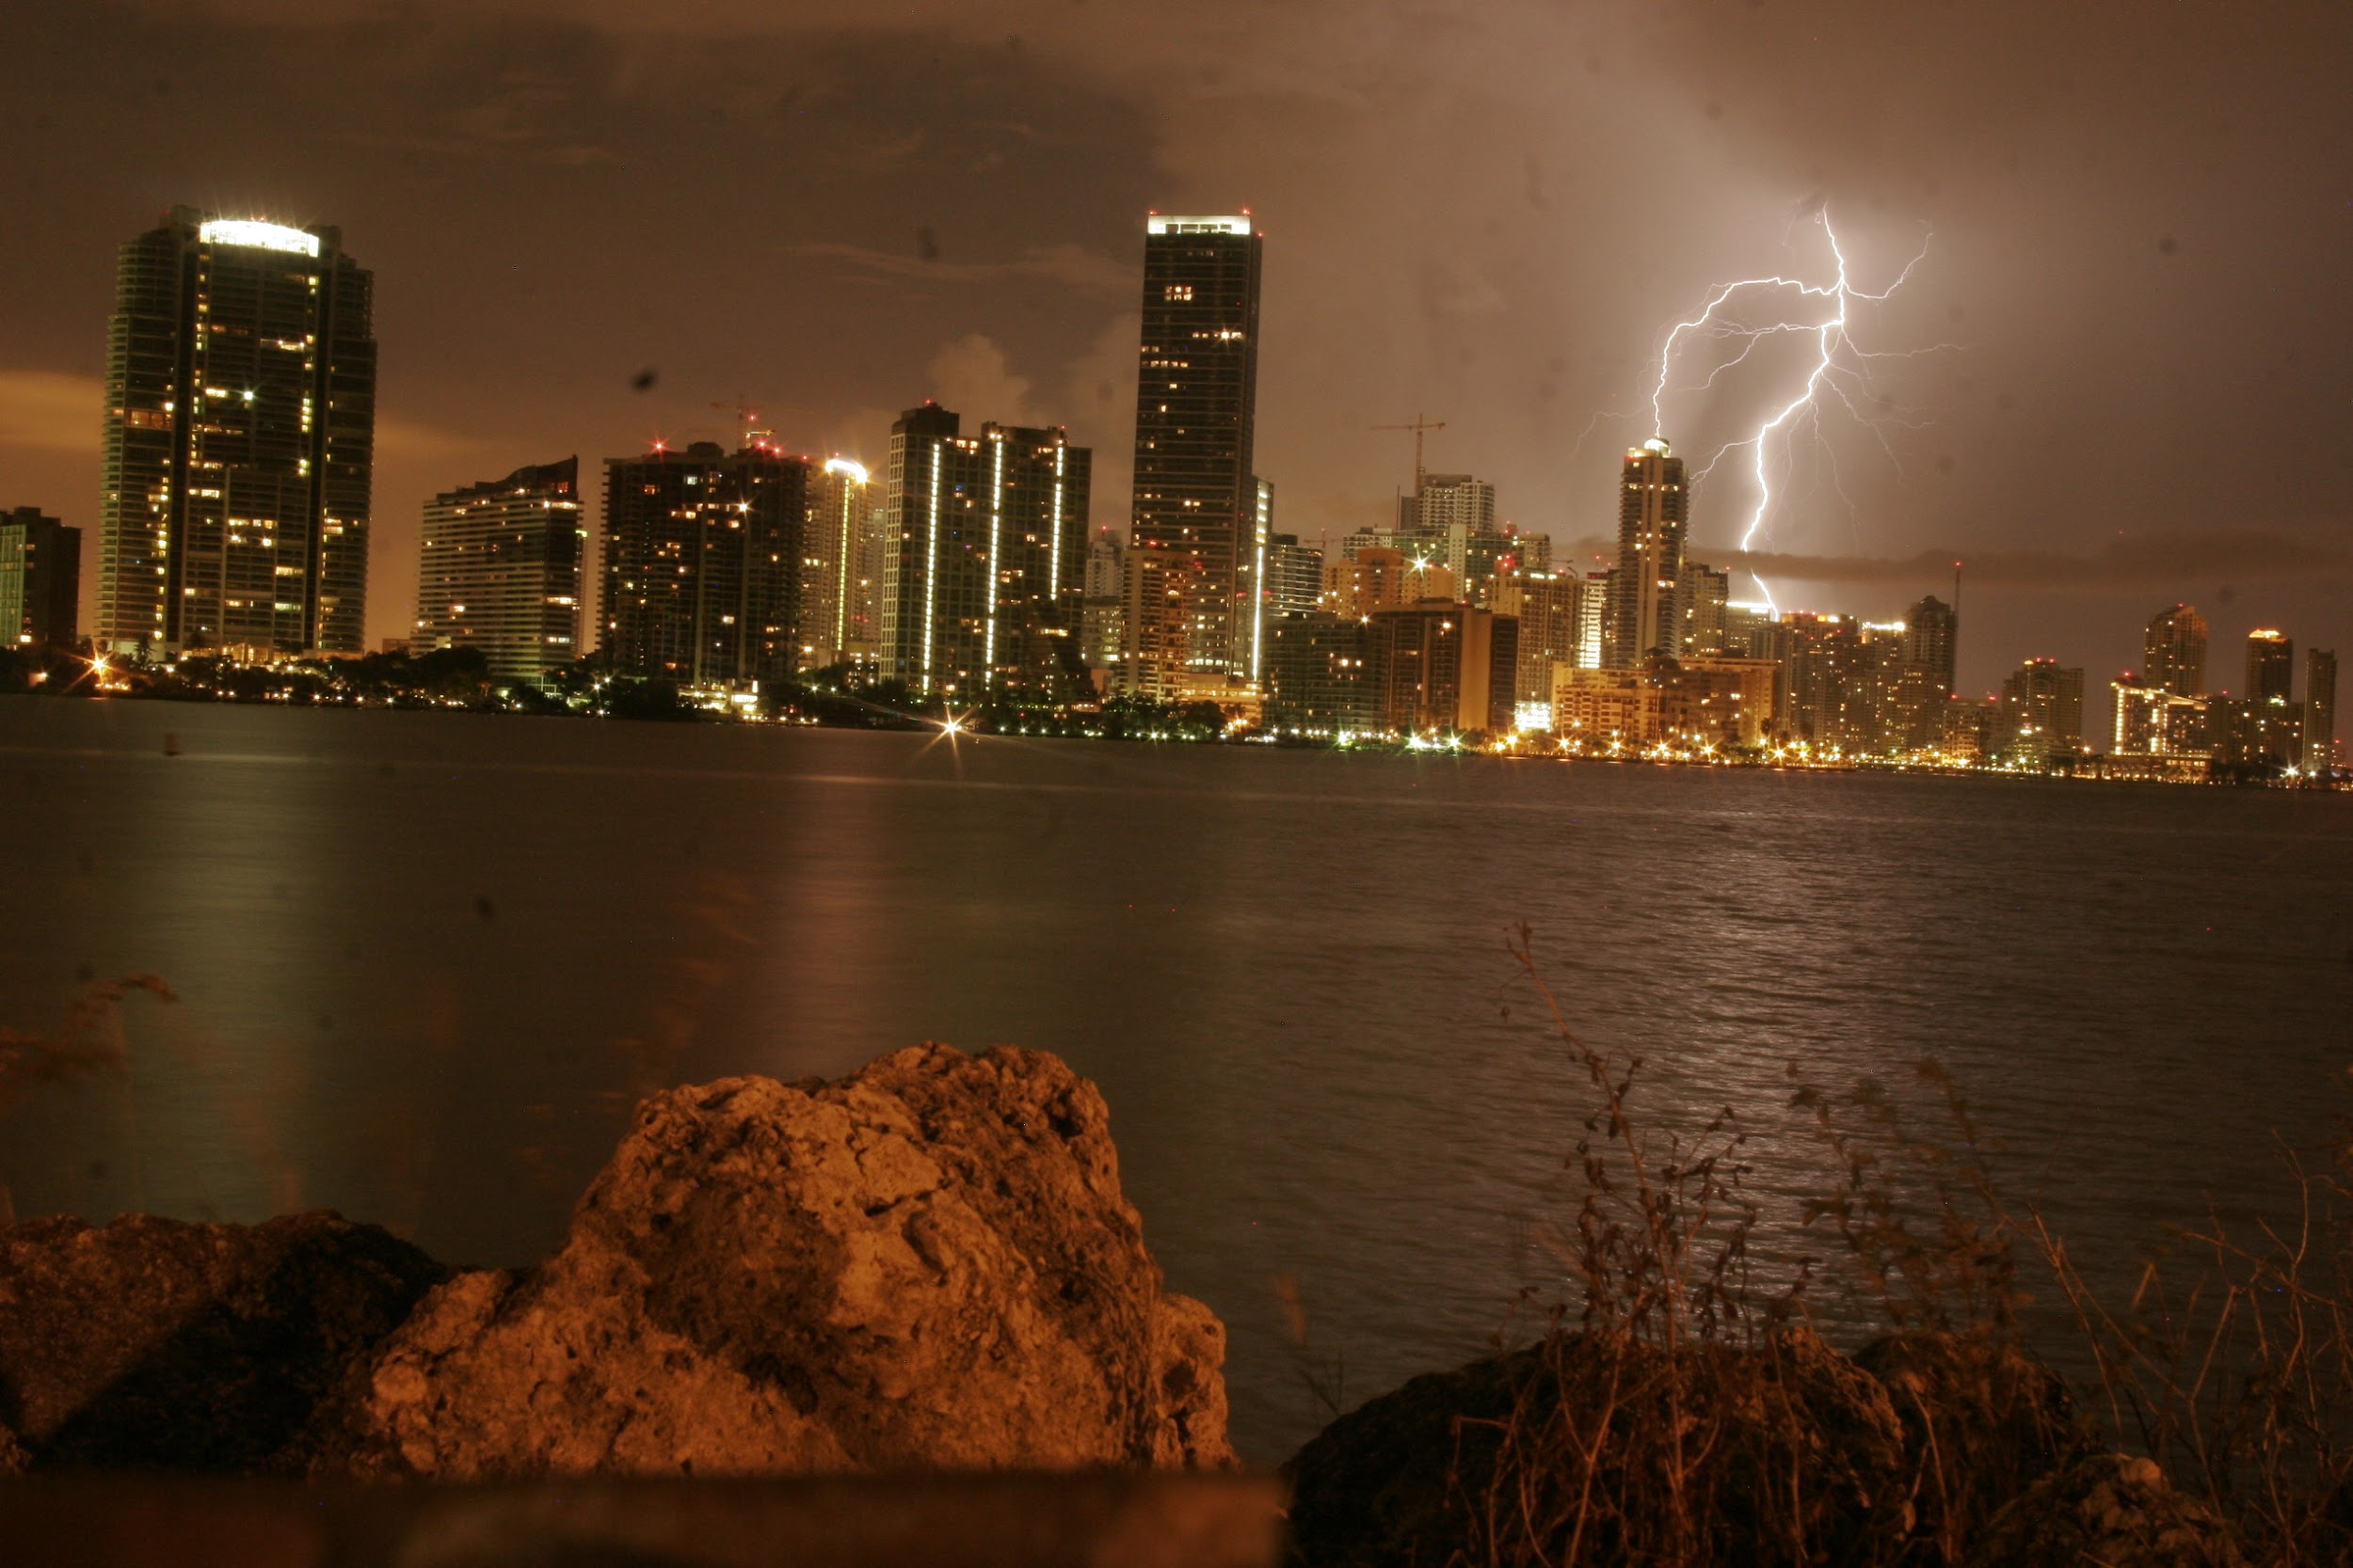
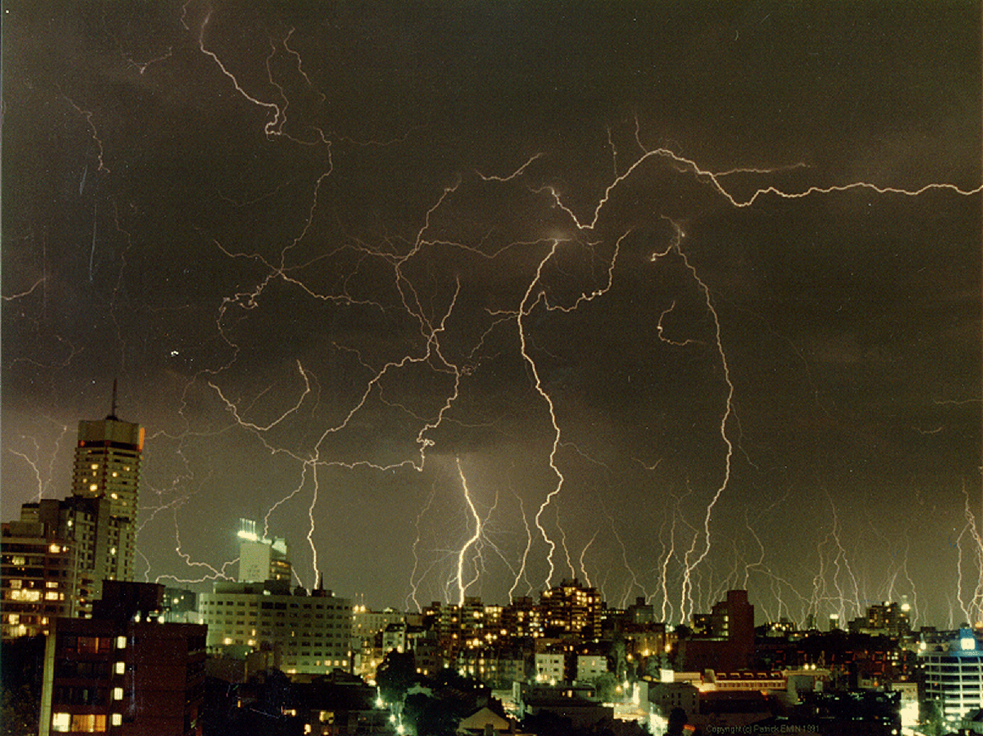
What is Thunder
Thunder is the sound of lightning. You don’t hear it at the same time because thunder does not move at the speed of light.

Slide 8
Websites
www.weatherwizkids.com/weather-thunderstorms.htm.
www.sciencekids.co.nz/sciencefacts/weather/thunder.html.
www.factmonster.com › Science › Weather.

