Slide 1
Tornadoes
By James, Shane, Jack and Tyler

Slide 2
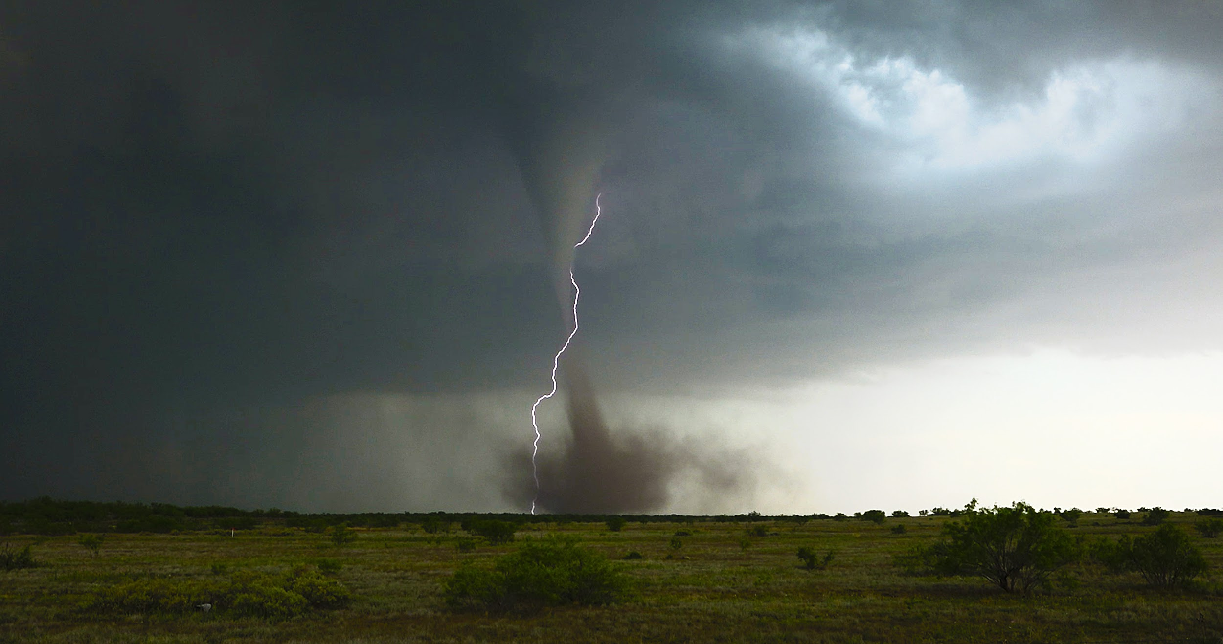
What is a tornado?
Some tornadoes start from thunderstorms
A tornado is high winds and dust
When cold and hot air meet, it forms a tornado

Slide 3
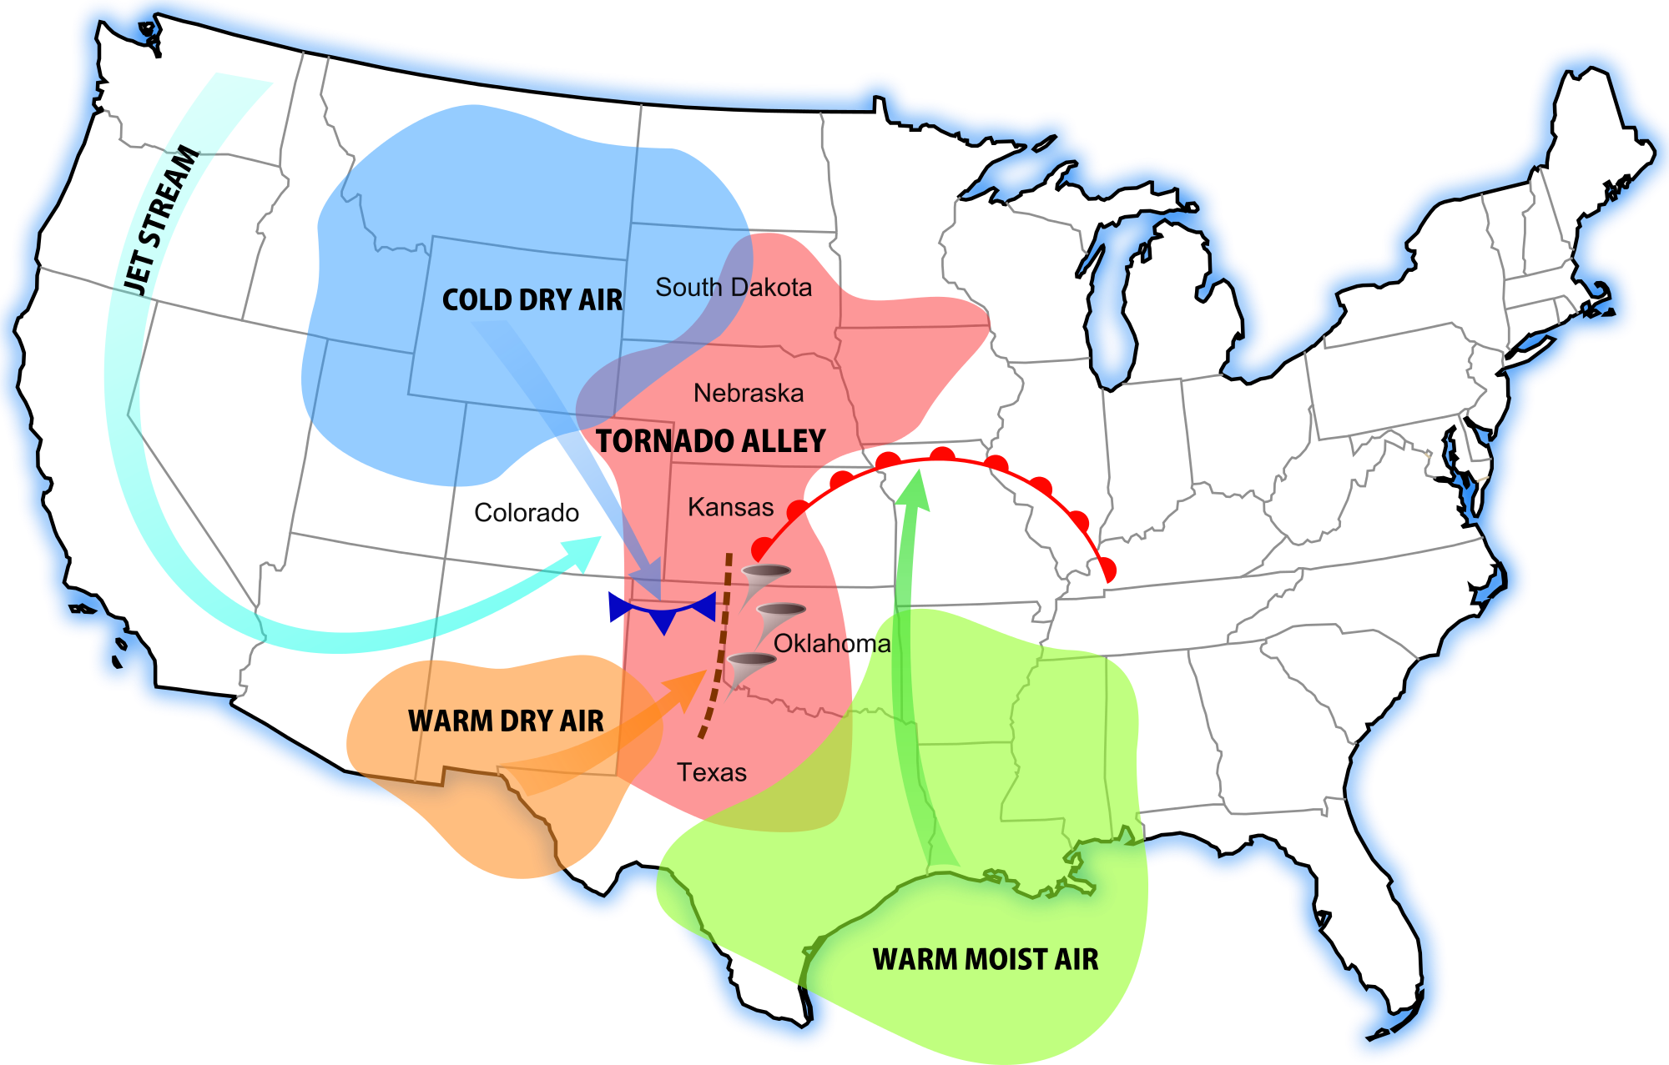
Tornadoes
Tornadoes can usually be found at Texas and Kansas
They usually are made close to the middle of the earth
Tornadoes can happen in another place that is not in the middle of the earth. They can happen near the water but it is rare.

Slide 4
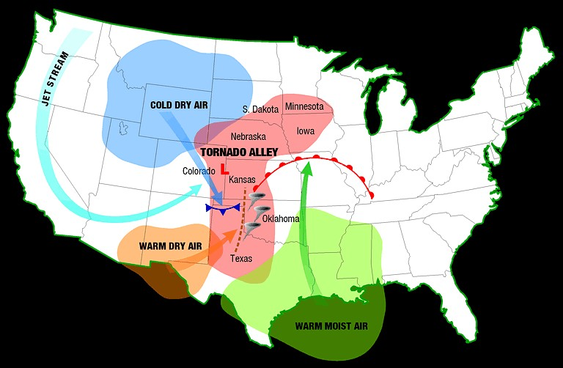
Why don’t tornadoes happen up north?
Cold air moves west to east. Up north, there is no warm.
Cold air and cold air can’t meet to make a tornado.
Tornadoes don’t happen up north because there is only cold air.

Slide 5
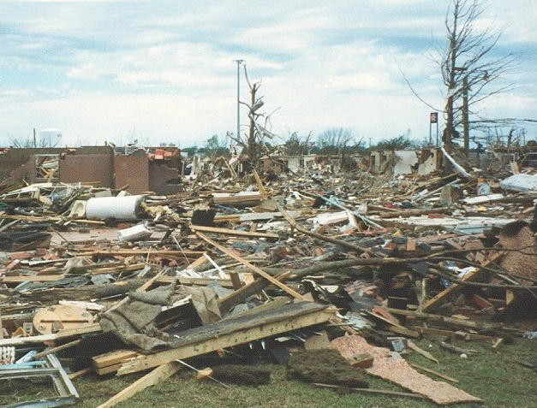
Tornadoes Damage
Tornadoes can destroy buildings and houses.
Tornadoes can also send things flying. They can kill people too.

Slide 6
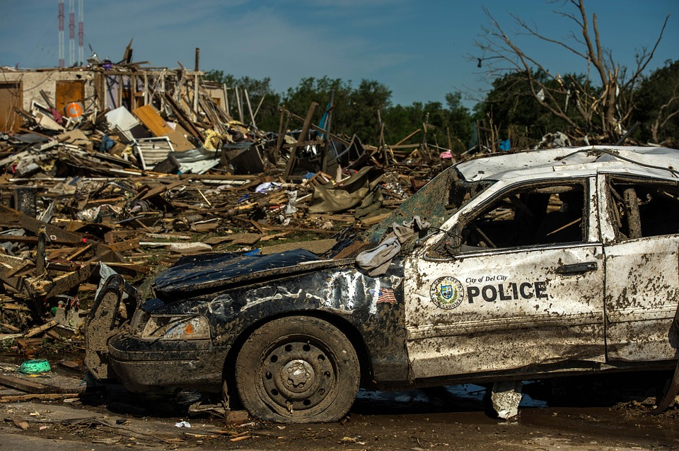
How dangerous can tornados get
Tornados speed up to 75 mph
Tornadoes are most dangerous in Texas
Tornadoes can get so dangerous that they can destroy a whole city!

Slide 7
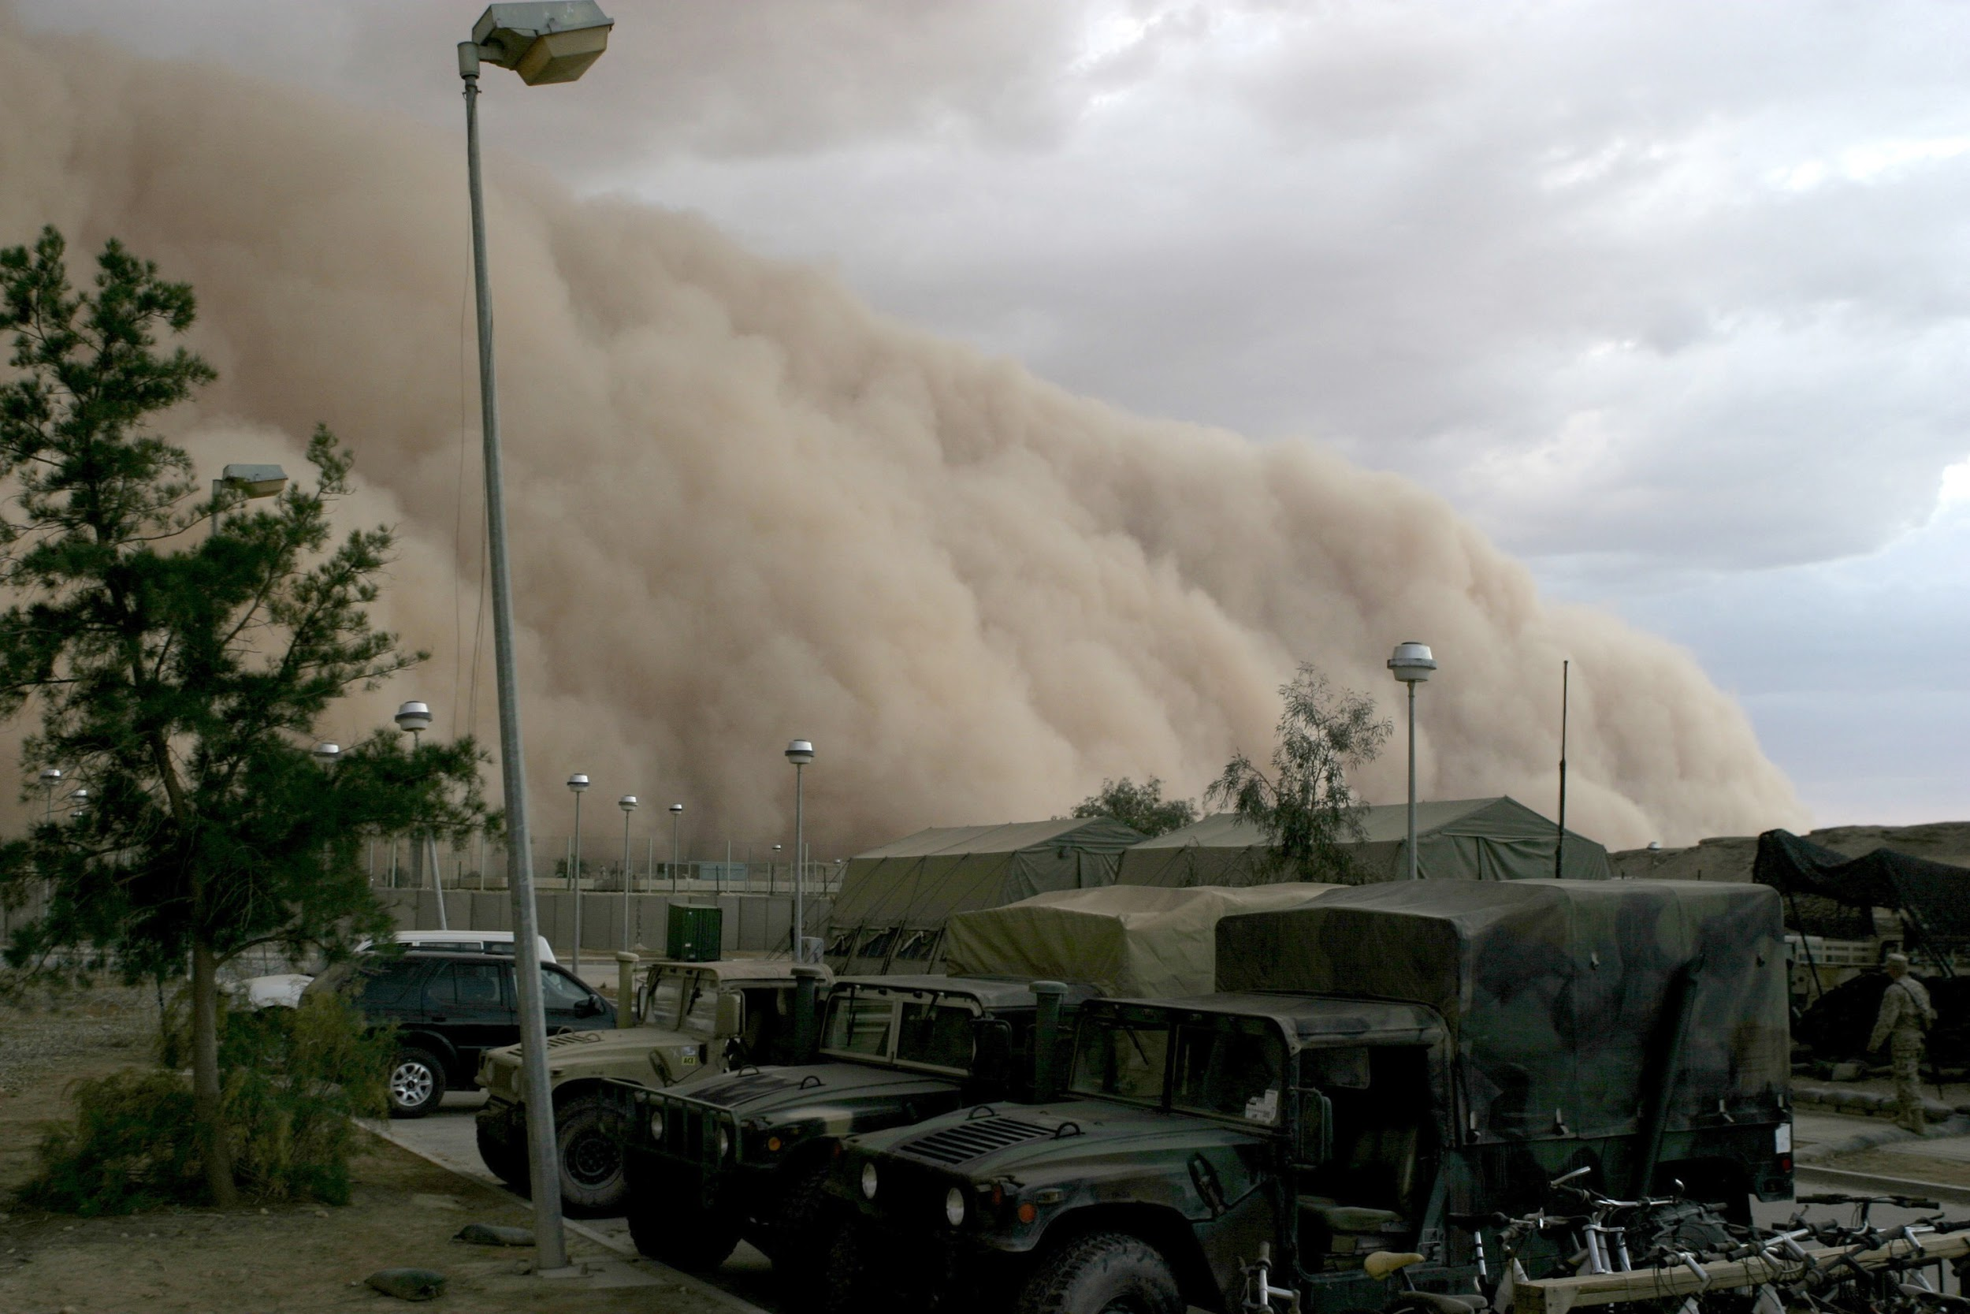
Can tornadoes cause another dangerous storm
Can tornadoes cause other dangerous storms?
Yes they can start earthquakes and when earthquakes can start a tsunami can start.
Another reason tornadoes are violent is because it other storms.
Tornadoes are dangerous not just because of its high winds but because it can cause other storms too.

Slide 8
Websites Used
http://www.weatherwizkids.com/weather-tornado.htm
http://kids.nationalgeographic.com/explore/science/tornado/#tornado.jpg

